Slide 1
05 | Controllers and Views
Susan Ibach | Developer Evangelist
Christopher Harrison | Content Developer

Slide 2
Module Overview
Executing code for the user
Using templates
Ensuring consistency
Forms

Slide 3
Executing code for the user

Slide 4
At the end of the day...
The user is simply calling a method
As a result, all we need to do is create a method

Slide 5
What does the method need to look like?
def name(request, optional_parameters)
The first parameter contains the request object, which has information about the data sent by the user
Additional parameters can be added

Slide 6
How do we send data to the user?
Return HttpResponse to send HTML and HTTP status codes
Return HttpResponseNotFound to send a custom 404 error
return HttpResponse('<html><body>Hello, Django!</body></html>')
return HttpResponseNotFound('<html><body>you seem lost</body></html>')

Slide 7
Creating a Hello, Django page

Slide 8
Using templates

Slide 9
How do I send back complex HTML?
Django supports templates for creating complex template
A template has a collection of placeholders for dynamic content

Slide 10
What are Django templates?
Inject custom code into HTML
Artist Details
Artist:
Year formed:
The Cure
1978

Slide 11
Template basics
Templates are essentially just HTML
Templates exist in a folder named templates
Has a code syntax similar to Python
But it's not actually Python

Slide 12
Template example
<html>
<head>
<title>{{ name }}</title>
</head>
<body>
<h1>{{ name }}</h1>
<div>{{ name }} formed in {{ year_formed }}</div>
</body>
</html>

Slide 13
Looping through collections
<ul>
{% for album in albums %}
<li>{{ album.name }}</li>
{% endfor %}
</ul>

Slide 14
How do I specify the use of a template
Use render_to_response
return render_to_response('template.html', {'variable_name':value});
First parameter is the name of the template
The second parameter is the collection of variables the template expects

Slide 15
Using a template

Slide 16
Forms

Slide 17
How do we submit data?
Data is of course submitted by using forms
You could, if you wanted to, create your forms manually
Additional work
Doesn't deal well with changes to the model

Slide 18
Can Django create forms for us?
As a matter of fact, it can!
(it'd have been silly to create a slide asking that if the answer was "no")

Slide 19
How can we create forms using Django
Create a form class
Bind a form class to a model

Slide 20
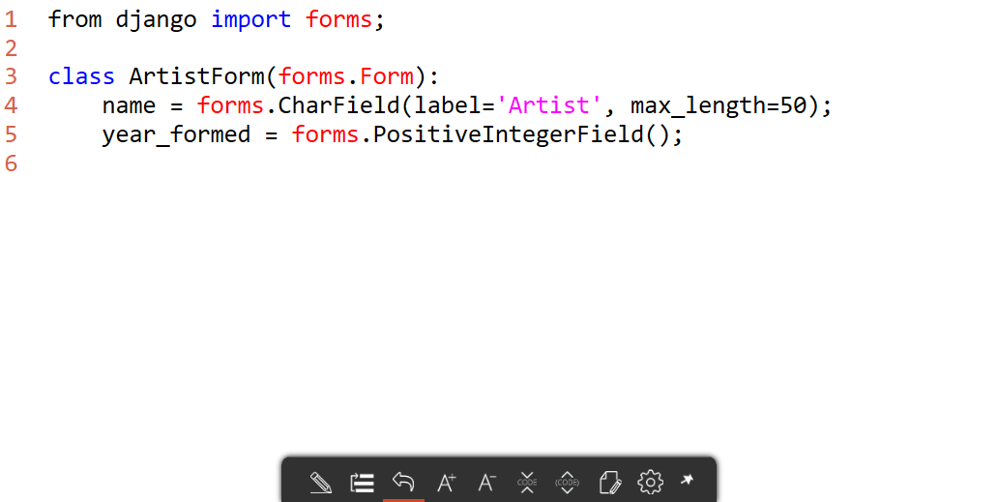
Form class

Slide 21
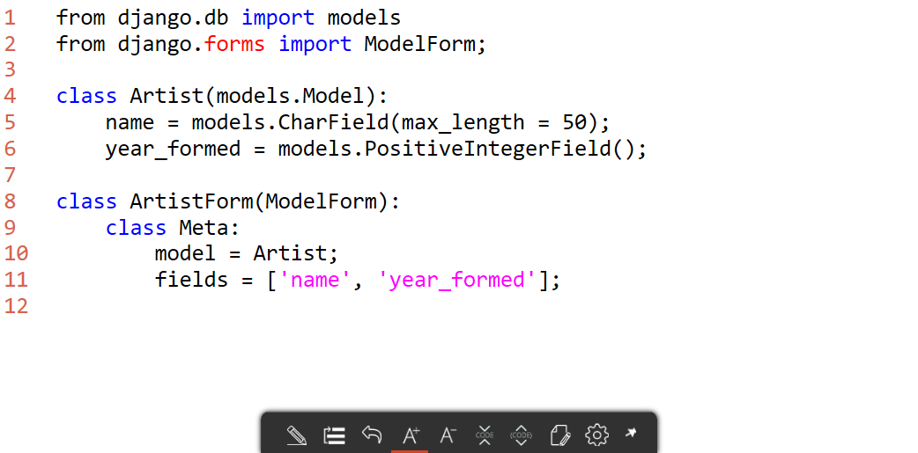
ModelForm

Slide 22
What's the advantage of binding the form to the model?
The form is automatically updated
The form has the ability to automatically validate data
You can save directly from the form

Slide 23
Creating a ModelForm

Slide 24
Creating the HTML
In order to create the form, you need an HTML page to "host" the form
It can be this simple:
<form method="post">
{% csrf_token %}
{{ form }}
<button type="submit">Save</button>
</form>

Slide 25
Controlling the form
By default, the form will be created as a table
{{ form.as_p }} will use <p> elements
{{ form.as_ul }} will use <li> elements
It is possible to grab the actual fields and completely customize the HTML as needed

Slide 26
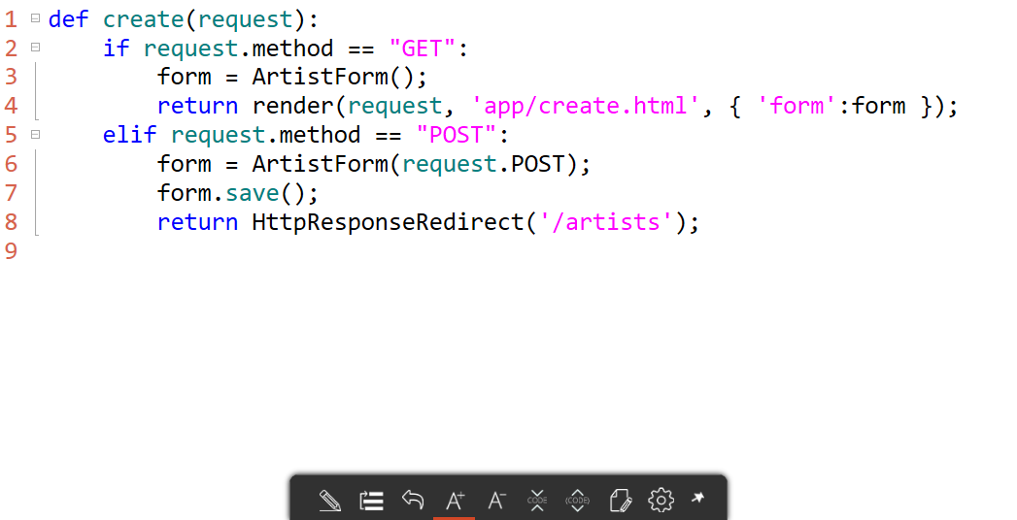
Using the form in the view

Slide 27
Creating a create form

